Slide 1
Symmetric Key Algorithms
DES, IDEA, RC5, Blowfish, AES
S-DES, DES, Triple DES

Slide 2
Prerequisites
Algorithm Types – An Algorithm type defines what size of plain text should be encrypted in each step of the algorithm.
Algorithm Modes – The algorithm mode defines the details of the cryptographic algorithm, once the type is decided.

Slide 3
Algorithm Types
Stream Ciphers – It involves encryption / decryption of one plain text / cipher text bit at a time.
Block Ciphers – It involves encryption / decryption of one plain text / cipher text block at a time.

Slide 4
Stream Ciphers - An Example
In text format
In binary format
Pay 100
010111001
In binary format
XOR operation
100101011
Key
ZTU91^%D
110010010
Cipher text

Slide 5
Block Ciphers - An Example
FOUR
_AND_
FOUR
Plain text
Encrypt
Encrypt
Encrypt
VFA%
*yT1x
VFA%
Cipher text

Slide 6
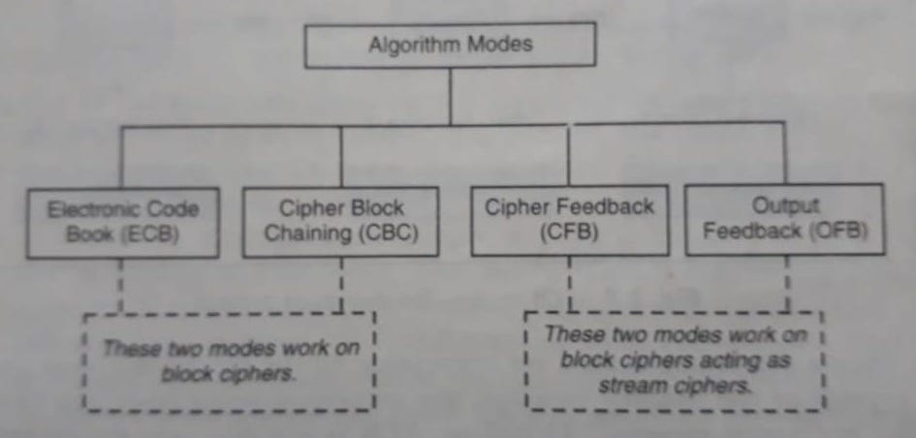
Algorithm Modes

Slide 7
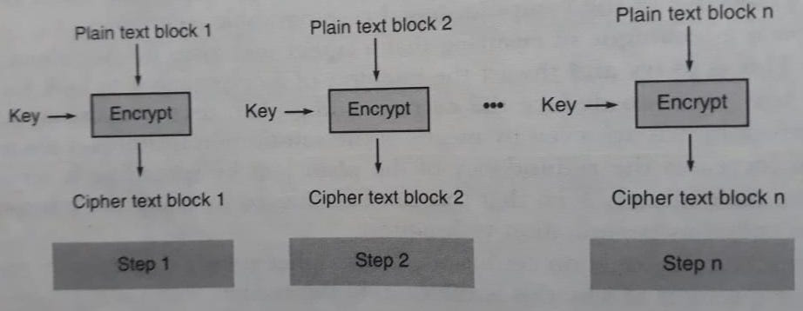
Electronic Code Book(ECB) Mode --- Encryption ---

Slide 8
Electronic Codebook (ECB) is a simple mode of operation for block ciphers, where each block of plaintext is independently encrypted with the same key.
Limitations:
1. Deterministic: Identical plaintext blocks result in identical ciphertext blocks, which can lead to patterns and vulnerabilities.
2. No Diffusion: Small changes in the plaintext don't affect the rest of the ciphertext, making it susceptible to certain types of attacks.
3. Key Management: The key must be securely managed and updated; compromise of the key jeopardizes the entire message.
4. Lack of variability: Same key usage for encryption results in same ciphertext for a given plaintext.

Slide 9
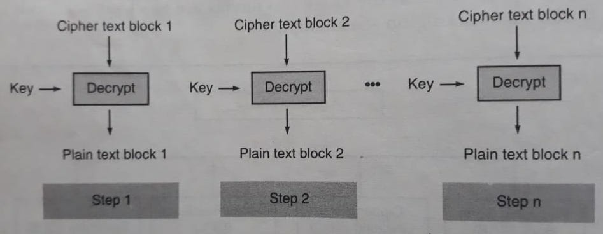
Electronic Code Book(ECB) Mode --- Decryption ---

Slide 10
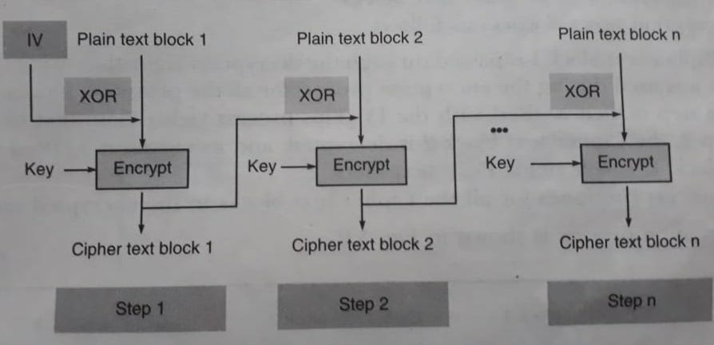
Cipher Block Chaining(CBC) Mode --- Encryption ---

Slide 11
Cipher Block Chaining (CBC):
Description:
Operation: In CBC mode, each plaintext block is XORed with the ciphertext of the preceding block before encryption. The first block is XORed with an Initialization Vector (IV).
Initialization Vector (IV): A unique, random value that is used to initialize the first block's XOR operation. The IV adds randomness to the encryption process.
Advantages and How it Solves ECB Issues:
Diffusion: XORing the plaintext with the previous ciphertext introduces diffusion, where changes in one part of the plaintext affect the entire ciphertext block. (Addresses the deterministic encryption and lack of diffusion issues of ECB)
Pattern Recognition: The XOR operation disrupts patterns, reducing the predictability of repeated plaintext patterns.
Enhances security by mitigating the vulnerability to pattern-based attacks.
Security for Large Messages: Each block depends on the previous ciphertext, making it more challenging for an attacker to exploit repetitions in large messages.
Initialization Vector: Introducing an IV ensures that even if the same plaintext is encrypted multiple times with the same key, different ciphertexts are generated.
Result: Adds variability and prevents identical blocks from producing the same ciphertext.
Limitations:
Sequential Processing
Sensitivity to Flipping Bits

Slide 12
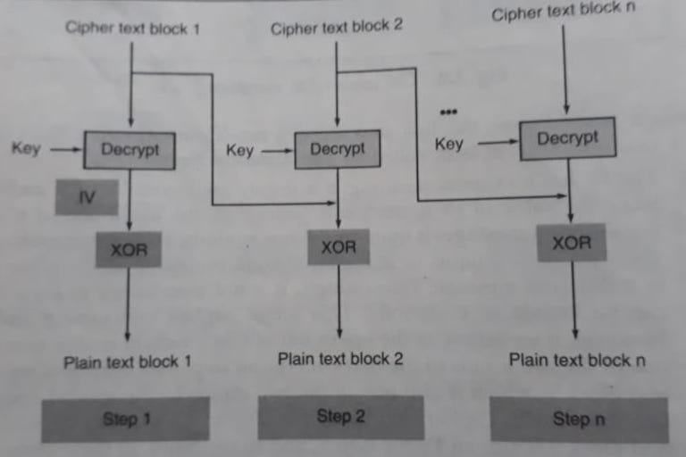
Cipher Block Chaining(CBC) Mode --- Decryption ---

Slide 13
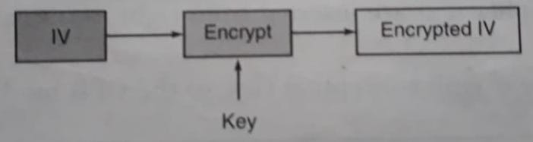
Cipher Feedback (CFB) Mode --- Step 1 ---

Slide 14
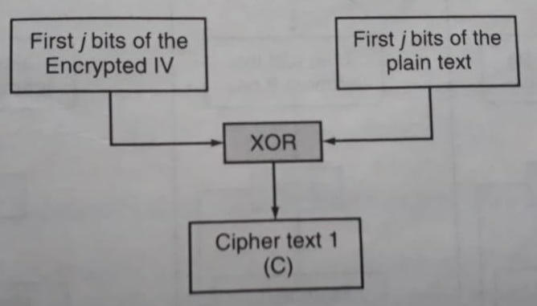
Cipher Feedback (CFB) Mode --- Step 2 ---

Slide 15
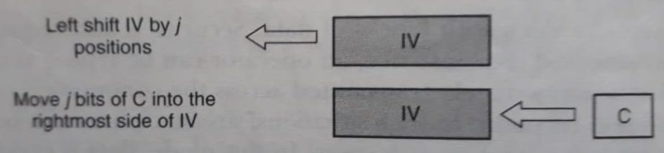
Cipher Feedback (CFB) Mode --- Step 3 ---

Slide 16
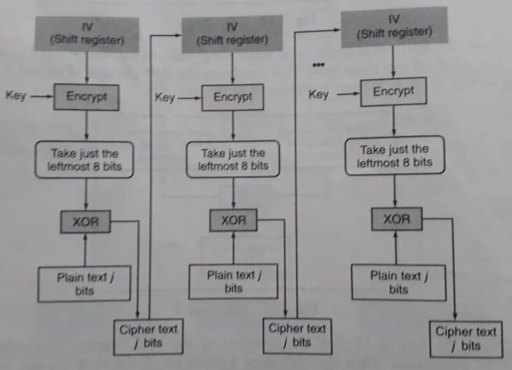
Cipher Feedback (CFB) Mode --- The Overall Encryption Process ---

Slide 17
CFB mode turns block ciphers into stream ciphers, allowing for the encryption of individual bits or bytes of data.
Result: Provides flexibility for encrypting streaming data without the need for padding or breaking the data into fixed-size blocks.

Slide 18
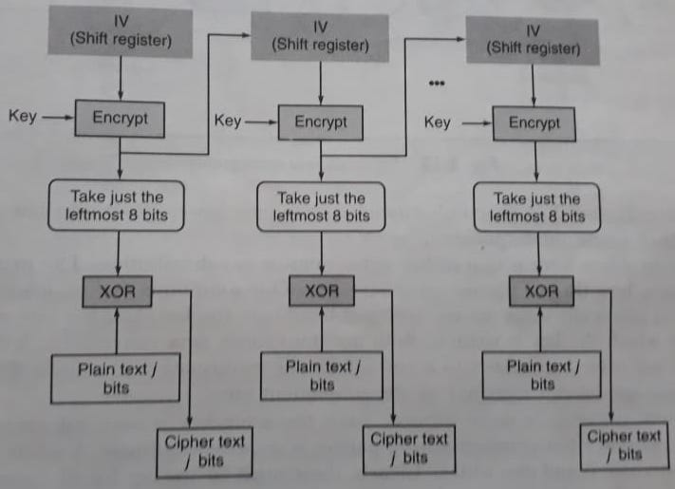
Output Feedback (OFB) Mode --- The Overall Encryption Process ---

Slide 19
Next Topic
Simplified Data Encryption Standard
(S-DES)

Slide 20
Thank you
Notes:
Is your presentation as crisp as possible? Consider moving extra content to the appendix.
Use appendix slides to store content that you might want to refer to during the Question slide or that may be useful for attendees to investigate deeper in the future.

